Slide 1
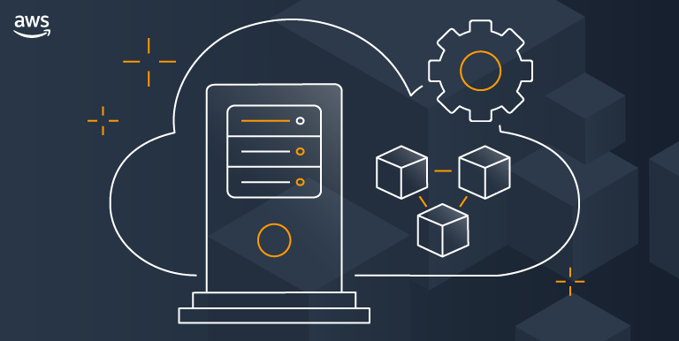




DEVELOPERIQ
PRODUCTIVITY CALCULATOR
CMM707 CLOUD COMPUTING
Devani Yasora Withanapathirana

Slide 2



CONTENT
DEVELOPERIQ SOLUTION
DEVELOPMENT ARCHITECTURE
EKS CLUSTER
MICROSERVICES
DYNAMODB DATABASE
CICD PIPELINE
TEST SUIT
MONITORING

Slide 3
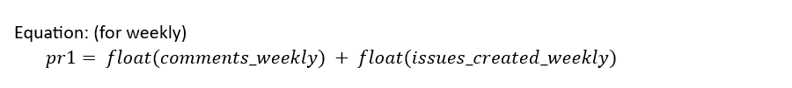
DEVELOPERIQ SOLUTION
Repository Details
Repo Owner :freeCodeCamp | Repo Name : Mobile (SHOW IN GITHUB)
productivity matrix: 1 : Summarized collected data
Calculated each and every developer’s total commit addition, total commit deletions, total number of commits in weekly, monthly and yearly basis
Summarize the number of issues created and issues comments for each developer for a weekly, monthly and yearly basis.
productivity matrix: 2 : User's productivity based on their interactions
Matrix 1 is calculated by combining the counts of comments and issues created by a developer. Reflects a user's productivity based on their interactions, such as comments and issues created, over different time intervals (weekly, monthly, and yearly).

Slide 4
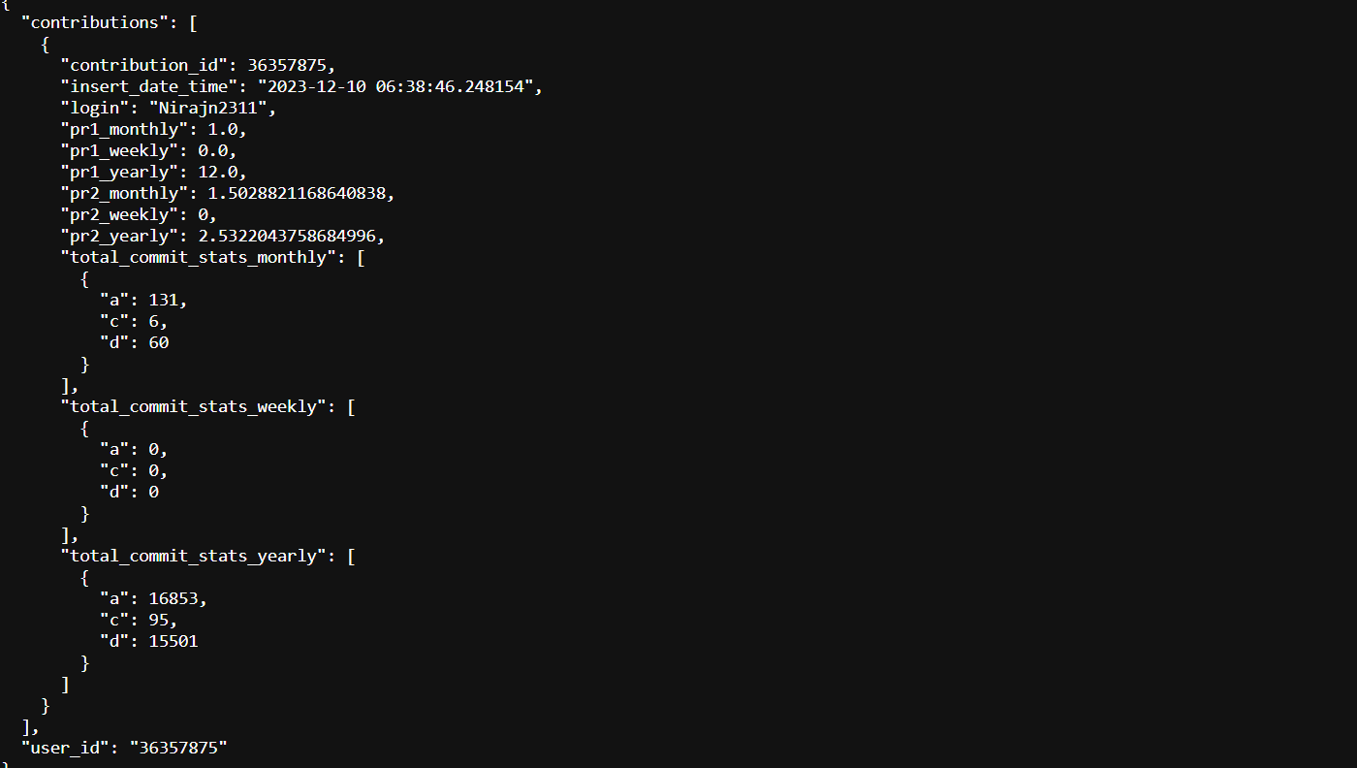
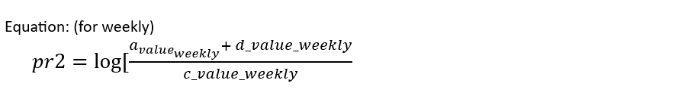
DEVELOPERIQ SOLUTION
productivity matrix: 3 : User's commit productivity
user's commit productivity by considering the logarithmic ratio of additions and deletions to the total number of commits
measure of the complexity or impact of a user's code changes.

Slide 5
DEVELOPMENT ARCHITECTURE
EKS CLUSTER
Set up Environment
IDE : AWS Cloud9 is a cloud-based integrated development environment (IDE) – EC2 : t3.small : Linux
Necessary Installations : kubectl , kubelet binaries , awscli and required enviromantal installations : jq, yq
IAM role for workspace : (instance role to provide administrative access to cloud9 to build EKS cluster) eksworkshop-admin : AdministratorAccess policy – Attache IAM to workspace EC2 and validate is.
Launch EKS cluster using EKSCTL
Download and install the eksctl

Slide 6
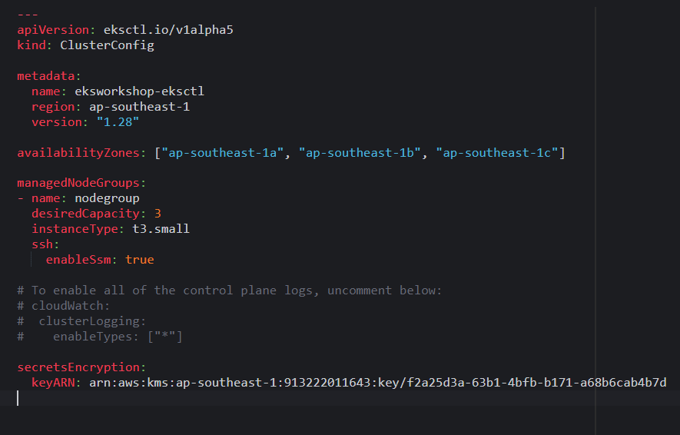
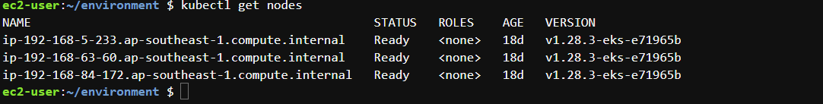
DEVELOPMENT ARCHITECTURE
EKS CLUSTER
Set up EKS Cluster:
configuration file for creating an Amazon EKS (Elastic Kubernetes Service) cluster using a tool called eksctl
enableSsm: Enables AWS Systems Manager (SSM) for SSH connectivity.
secretsEncryption: Configuration for encrypting secrets. keyARN: Amazon Resource Name (ARN) of the AWS Key Management Service (KMS) key used for encryption.

Slide 7
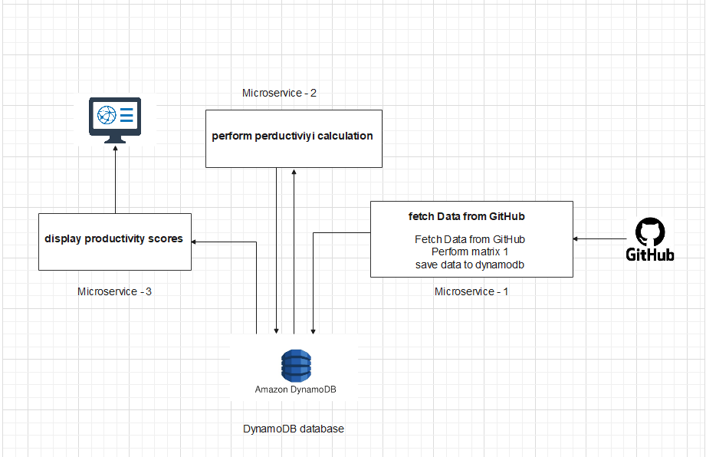
DEVELOPMENT ARCHITECTURE
MICROSERVICES
Show pods
Show services
Show deployments
Run microservices in web
Show outputs from microservices

Slide 8
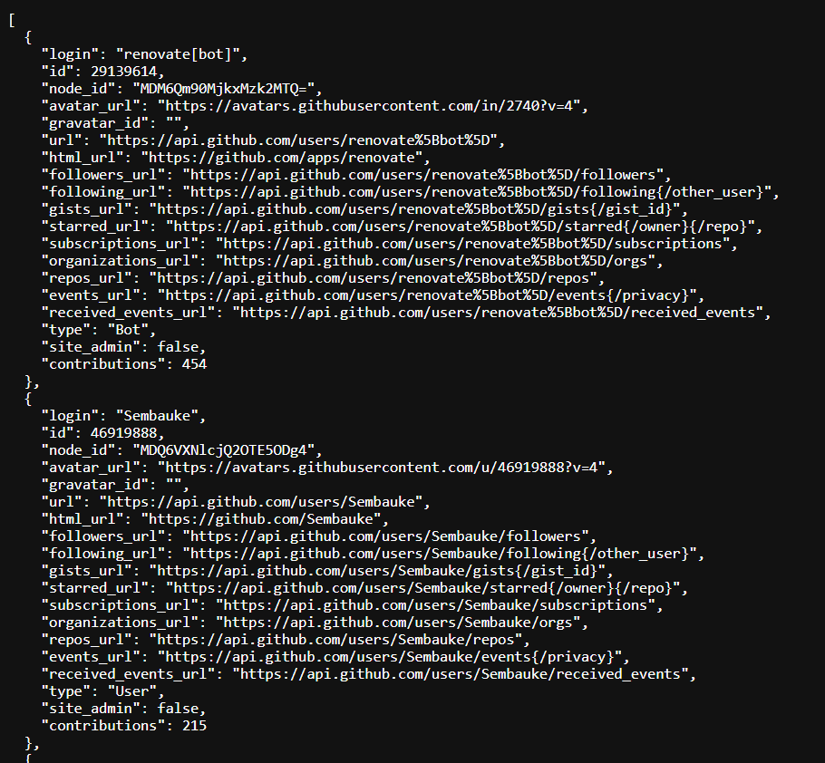
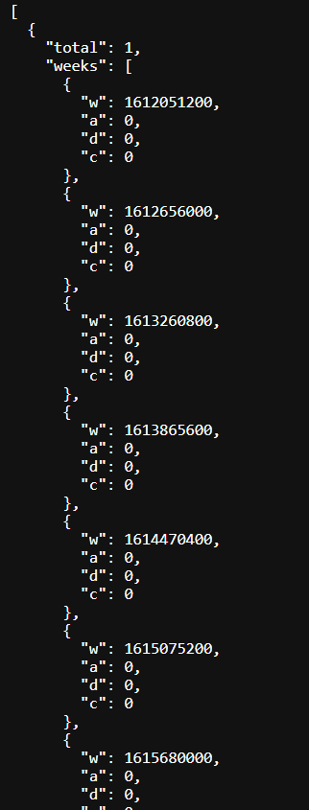
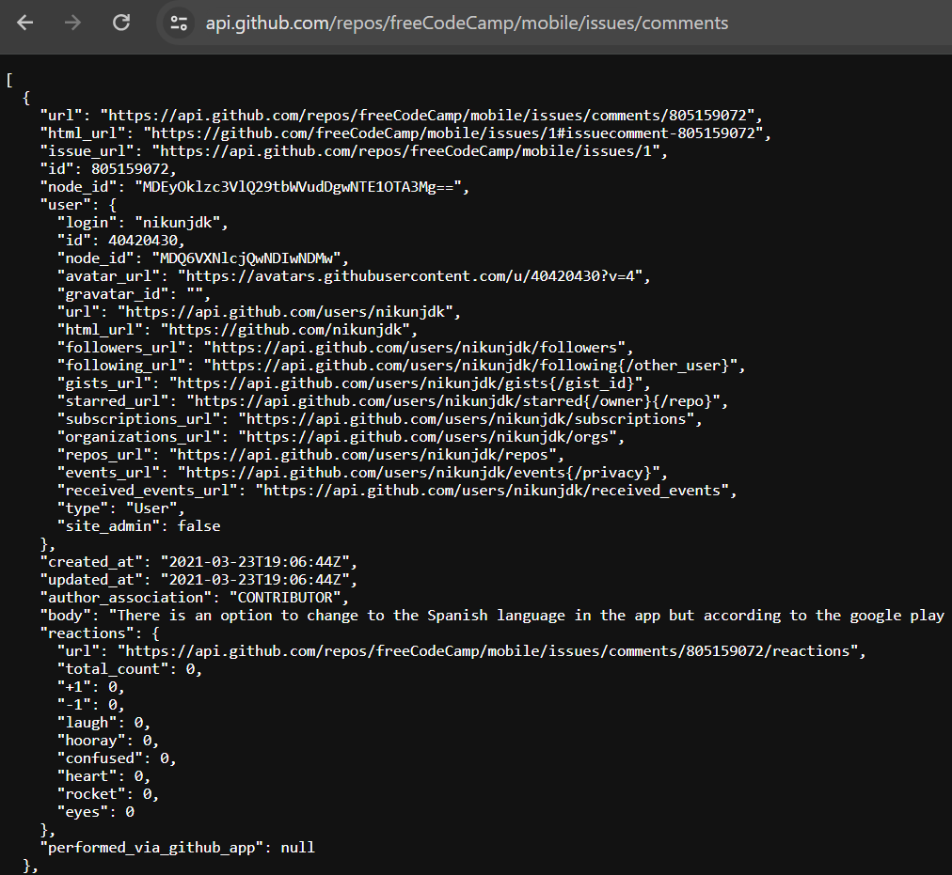
DEVELOPMENT ARCHITECTURE
MICROSERVICES – 1 : 4 GITHUB APIs
1- https://api.github.com/repos/freeCodeCamp/mobile/contributors (get contributeror loging details)
2- get_commit_stats(repo_owner, repo_name, contributor_login, token, time_frame) : https://api.github.com/repos/freeCodeCamp/mobile/stats/contributors (calculate weekly, monthly and yearly a,d,c values)
3- CONTRIBUTOR_ISSUES_URI__(repo_owner, repo_name, contributor_login, token) : https://api.github.com/repos/freeCodeCamp/mobile/issues/comments (comments on issues - calculate number of comments on a issue by a user)

Slide 9
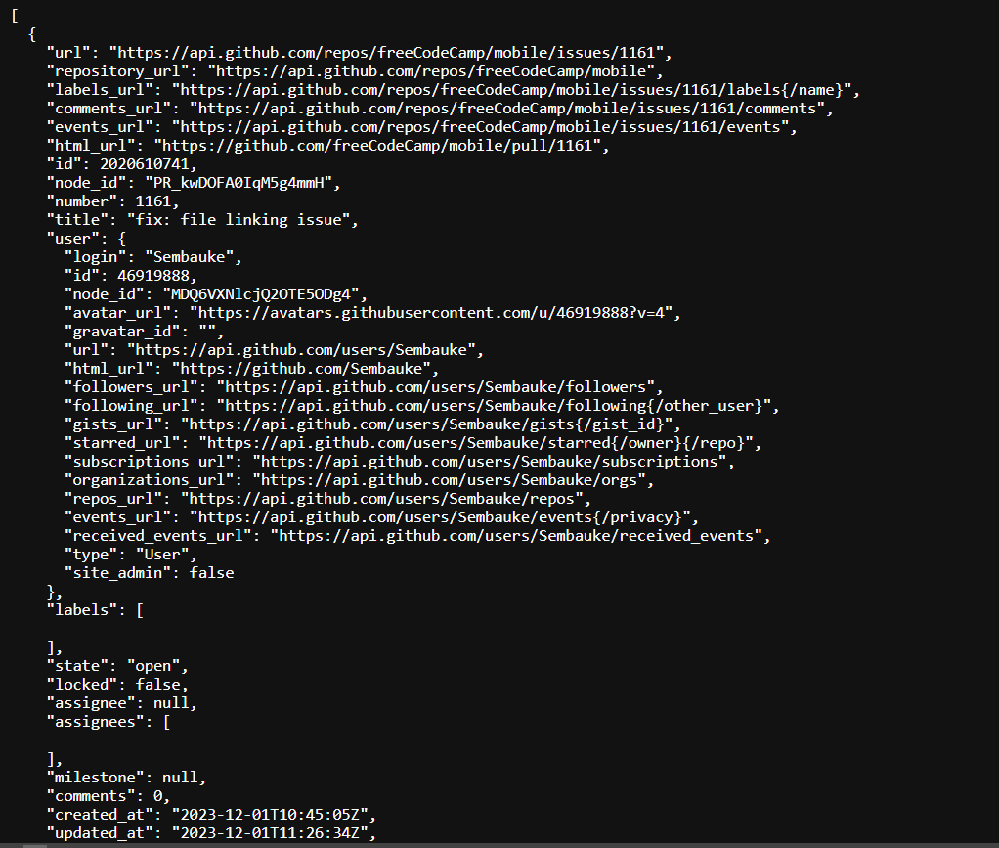
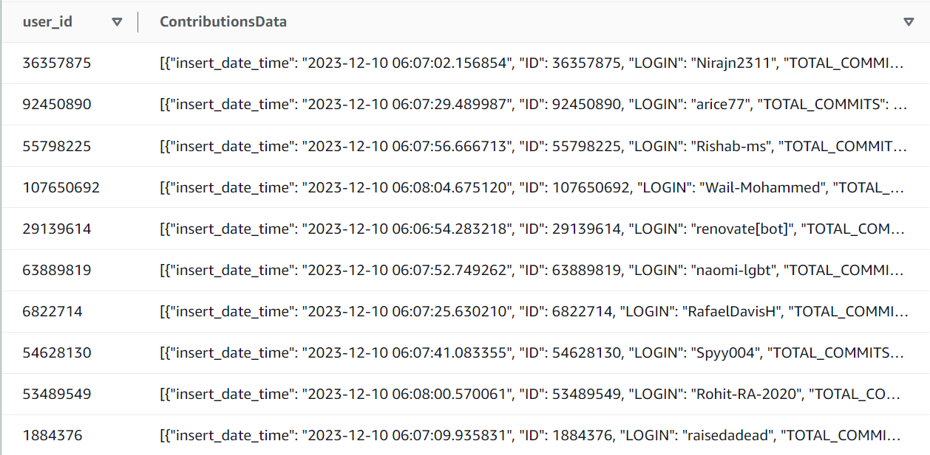
DEVELOPMENT ARCHITECTURE
MICROSERVICES - 1
4- CONTRIBUTOR_ISSUES_URI__(repo_owner, repo_name, contributor_login, token): https://api.github.com/repos/freeCodeCamp/mobile/issues (calculate the number of issues created weekly, monthly and yearly.
FINALLY: Insert data to a table in DynamoDB

Slide 10
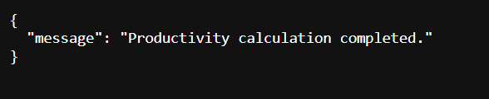
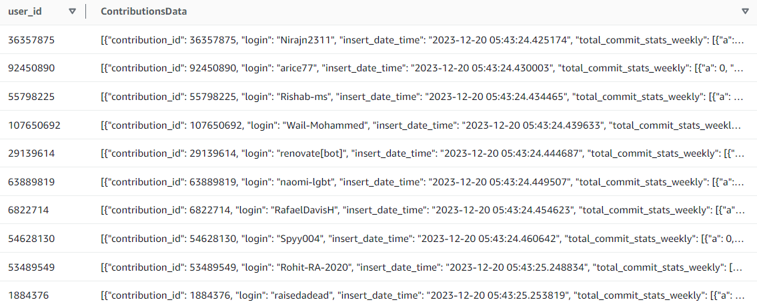
DEVELOPMENT ARCHITECTURE
MICROSERVICES - 2
Perform productivity calculations.
MICROSERVICES - 3
Display final productivity values.

Slide 11
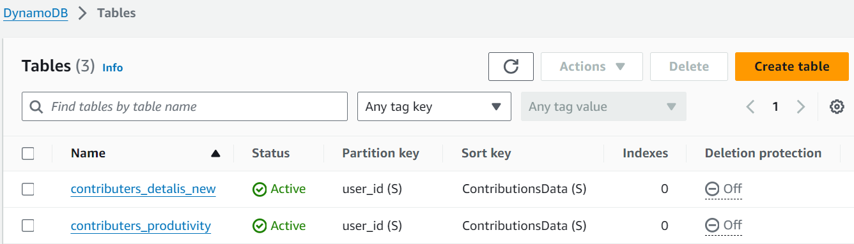
DEVELOPMENT ARCHITECTURE
DYNAMODB DATABASE
Show python script used to create tables in database

Slide 12
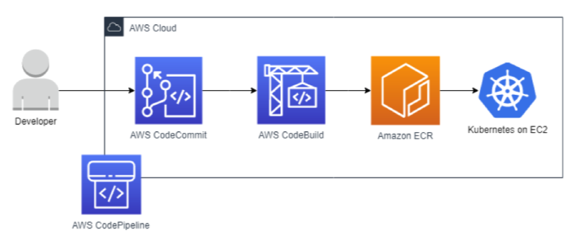
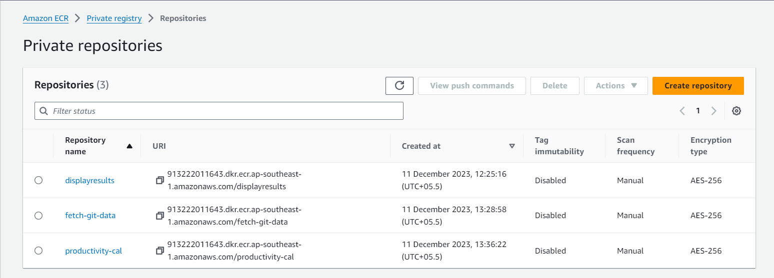
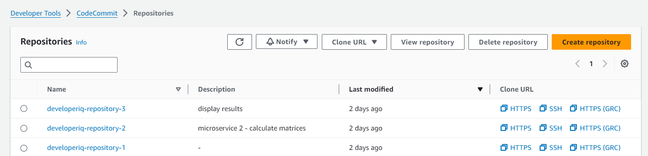
DEVELOPMENT ARCHITECTURE
CICD PIPELINE
ECR Repositories:
CodeCommit Repositories:

Slide 13
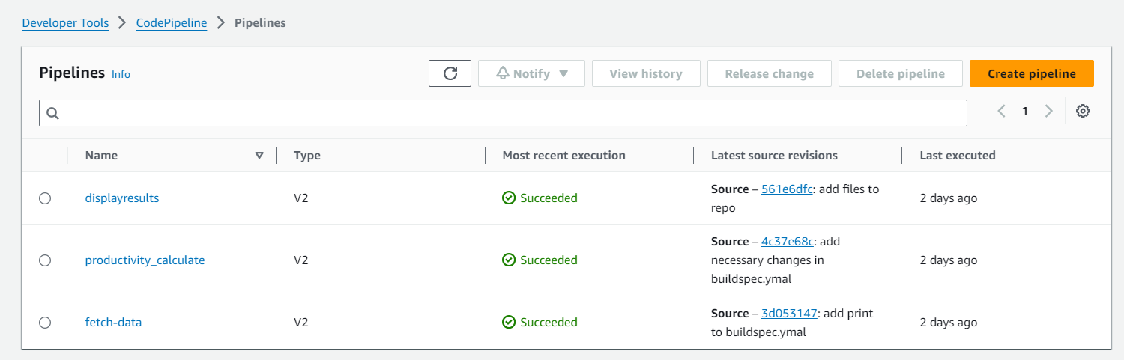
DEVELOPMENT ARCHITECTURE
CICD PIPELINE
Code pipelined for 3 microservices:
Show CICD pipelines

Slide 15
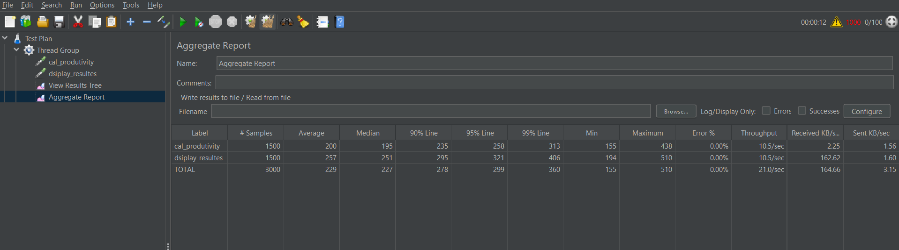
DEVELOPMENT ARCHITECTURE
TEST SUITE
JMeter
TEST SUITE
TEST SUITE

Slide 17
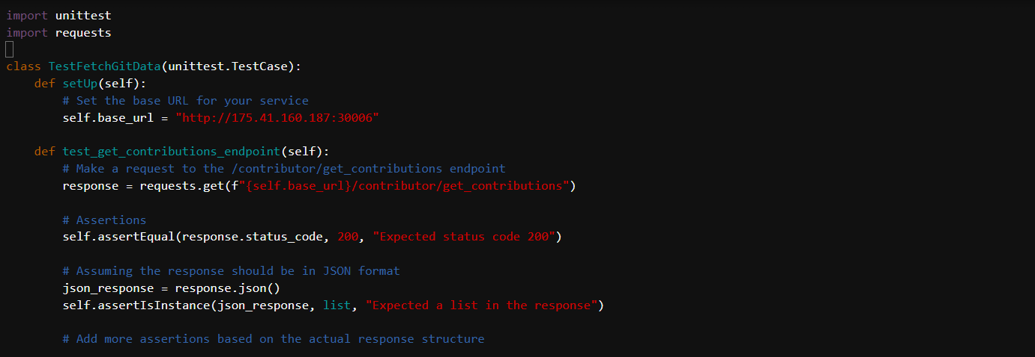
DEVELOPMENT ARCHITECTURE
TEST SUITE
Sample test case code implemented for Microservice 1- Extract data from GitHub:
Unit test for an HTTP GET request to a specific endpoint of a web service. It verifies the expected status code and the format of the JSON response. If any assertions fail during the test execution, the test will report an error.
Python unittest – Show output using cloud9

Slide 18
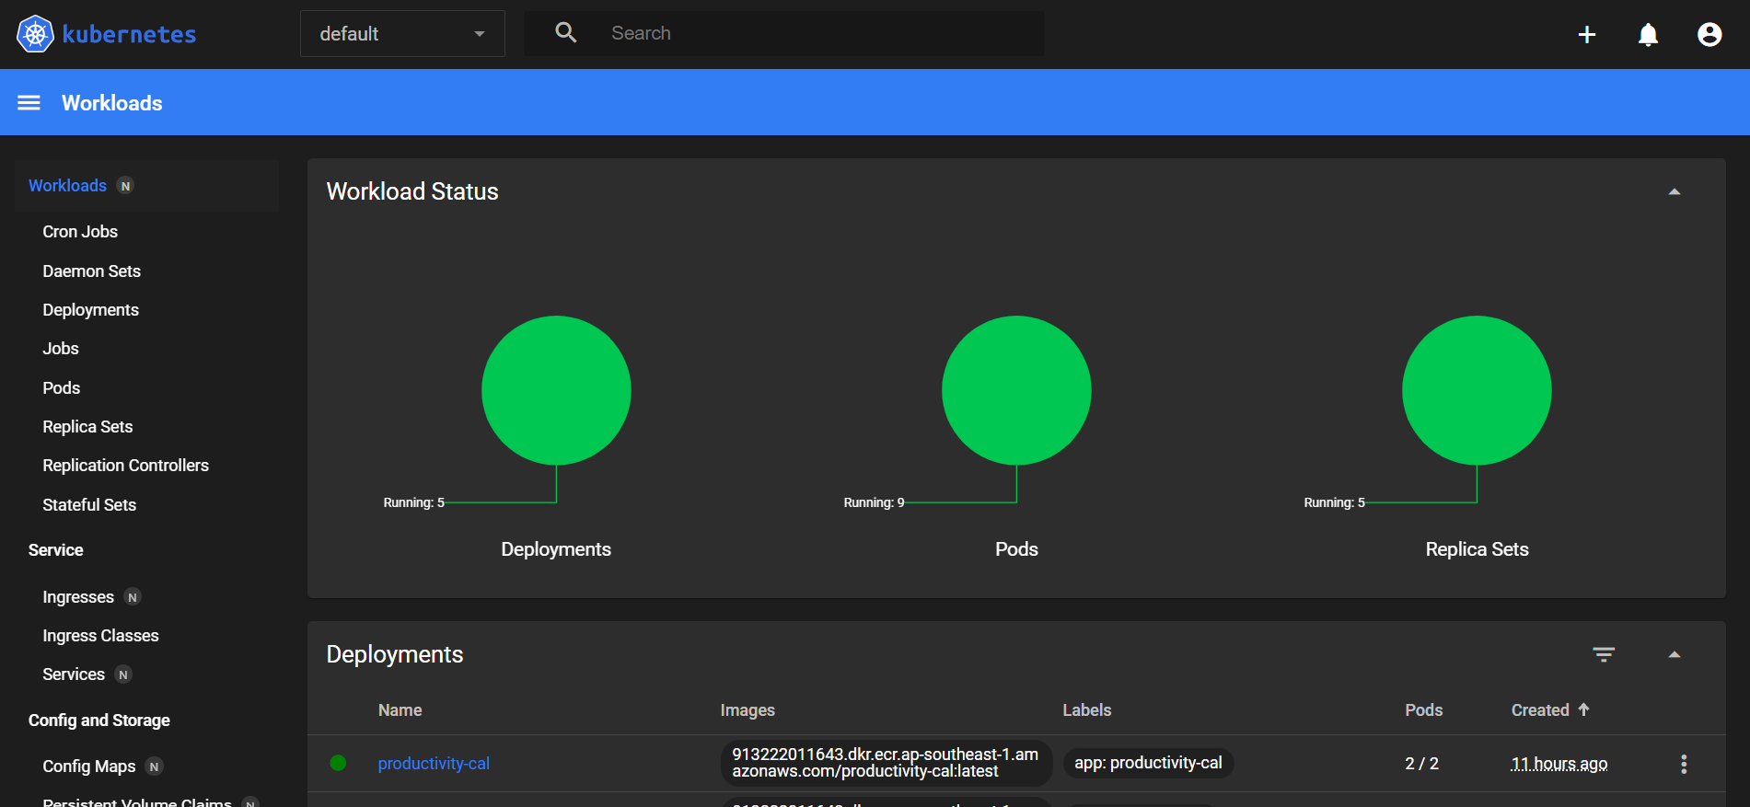
DEVELOPMENT ARCHITECTURE
MONITORING
Show output using Dashboard
Notes:
export DASHBOARD_VERSION="v2.7.0“ kubectl apply -f https://raw.githubusercontent.com/kubernetes/dashboard/${DASHBOARD_VERSION}/aio/deploy/recommended.yaml
Run: kubectl proxy --port=8080 --address=0.0.0.0 --disable-filter=true &
aws eks get-token --cluster-name eksworkshop-eksctl | jq -r '.status.token’
Tools / Preview / Preview Running Application
/api/v1/namespaces/kubernetes-dashboard/services/https:kubernetes-dashboard:/proxy/

Slide 19
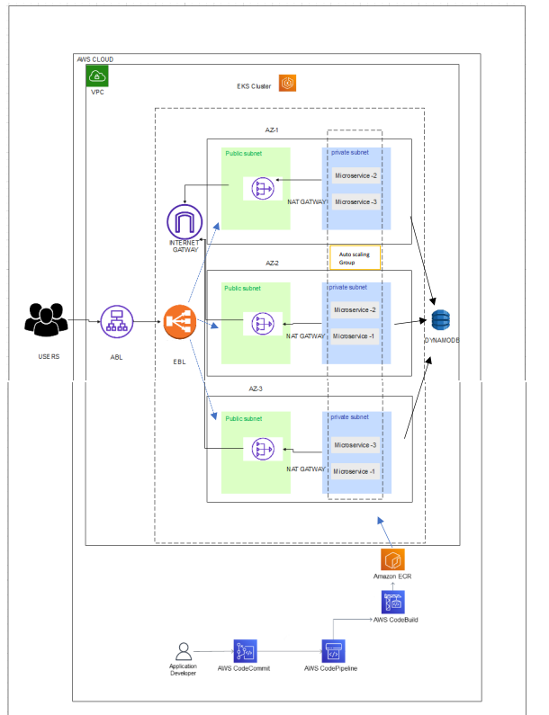
DEVELOPMENT ARCHITECTURE

Slide 20

Thank You !

